Slide 1
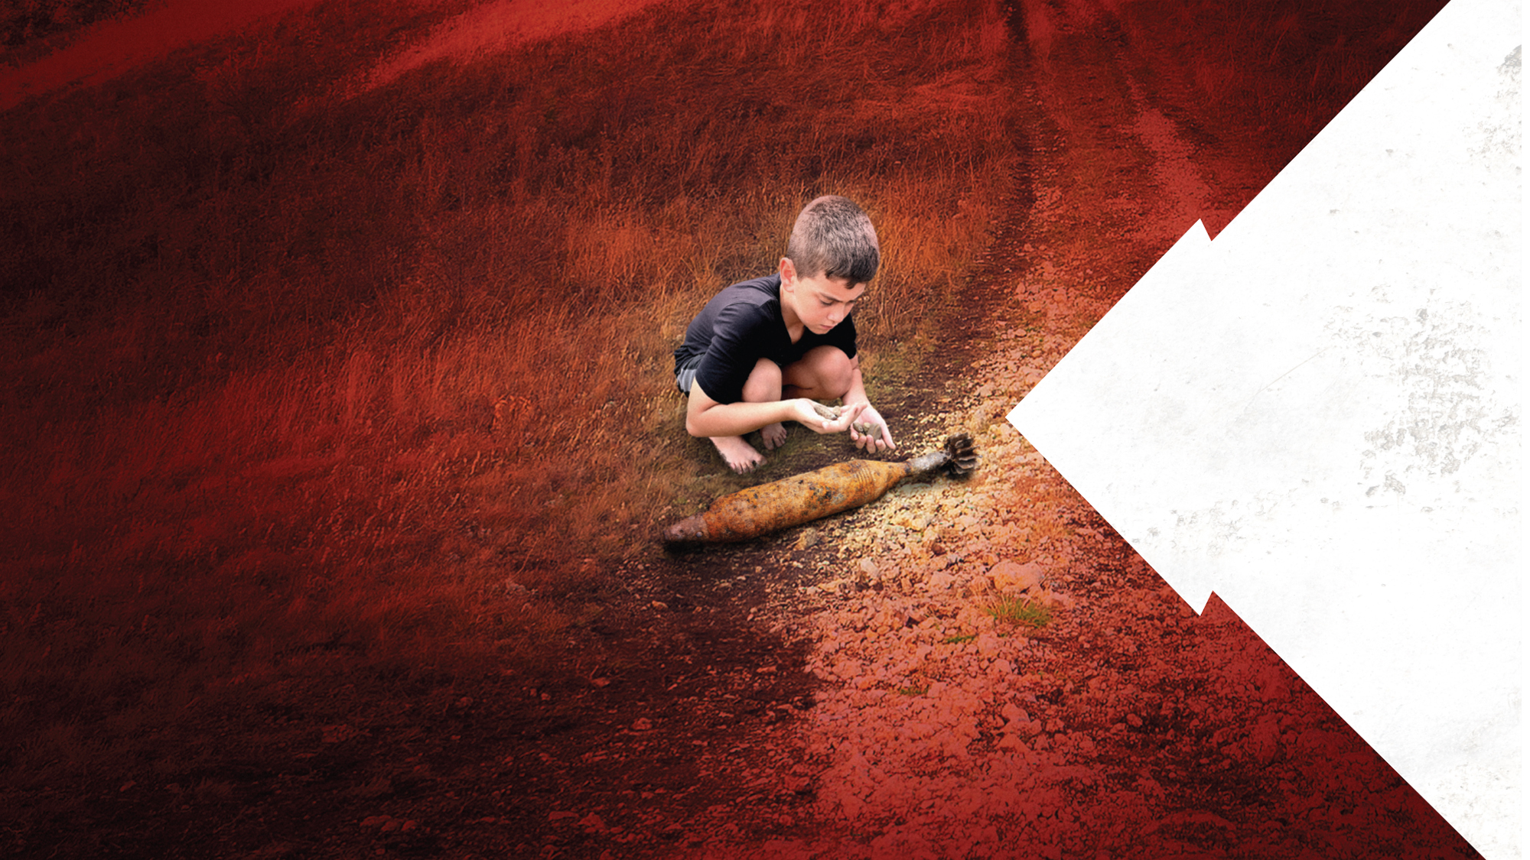
UneXploded Ordnance (UXO) Awareness and Safety
A Primary and Secondary School Resource
Notes:
Australia’s Department of Defence has launched a national campaign which aims to inform and educate members of the public, including children, about what to do if they encounter Unexploded Ordnance (UXO) on public or private land.
Teachers and parents have an important role to play in helping you keep safe. When it comes to UXO, it is likely that an adult will be nearby when you are playing outside, bushwalking or camping with your family, or on a school excursion. But sometimes you may be alone with friends.
You might have questions about an unusual object that you’ve seen?
Today, we will take a few minutes to learn some really interesting information that will help keep us all safe:
What UXO is and how to identify it
The history of UXO
What we can do to avoid danger
Teacher notes - key messages throughout the presentation:
Don’t touch it, record the location and immediately report it to police.
As long as you don’t touch or move the object, it will not hurt you.
If we know where unexploded ammunition or weaponry is located, we can safely remove or destroy them.
If you find any old bombs, projectiles or hand grenades, immediately inform the police.
Military souvenirs and keepsakes can also be very dangerous UXO.

Slide 2
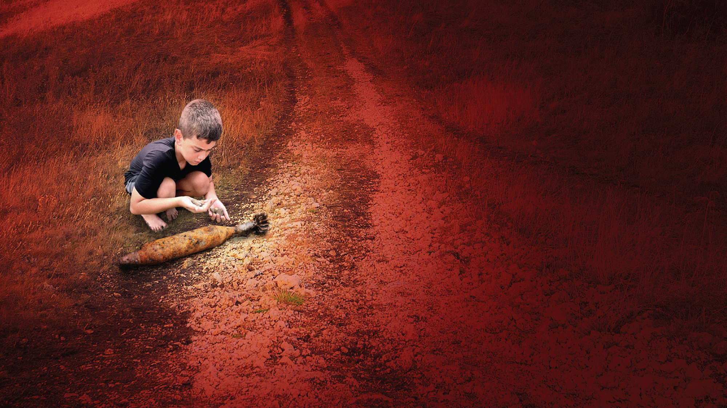
What is UneXploded Ordnance (UXO)?

Slide 3
What is UneXploded Ordnance (UXO)?
Military ammunition or explosives that have been primed and launched but remain unexploded.
Mortars, bombs, mines, artillery shells, hand grenades, rockets, missiles, and many other types of ammunition and explosives.
UXO in Australia, range from bombs and rockets to missiles and hand grenades.
Notes:
“Ordnance” is a military term that covers many types of dangerous ammunition.
“UXO” is an acronym – a short way of saying Unexploded Ordnance.
UXO is any military ammunition or explosives that have been primed, fused, armed or otherwise prepared for action, but remain unexploded. This means it hasn’t blown up. They have many names but include mortars, bombs, mines, artillery shells, hand grenades, bombs, rockets, missiles, and many other types of ammunition and explosives.
The UXO may have been fired from guns, shot from tanks or ships, or dropped from aircraft, but for whatever reason haven’t exploded as intended at the time.
In Australia, the most common types of UXO are due to our military forces conducting training exercises. They practice dropping bombs from aircraft, firing rockets and missiles from Navy, Army and Air Force equipment, or soldiers throw hand grenades and fire their guns so that they are the ready to defend Australia.

Slide 4
What is Unexploded (UXO)?
What Is Unexploded Ordnance
Notes:
Here you can see some of the many different types of UXO and what they may look like.

Slide 5
Why is UXO so dangerous?
Just because UXO failed to detonate initially, doesn’t mean it is safe.
Touching an old bomb, bullet or hand grenade can cause it to explode.
Military souvenirs and keepsakes can also be dangerous UXO.
Notes:
Human’s are curious creatures, and with that curiosity comes an increased chance of us touching something that looks unusual – but it’s important we don’t do that.
If you touch UXO, like an old bomb, bullet or hand grenade – it could be accidentally detonated and explode.
It could seriously injure, or even kill you or the people you are with.
The only people who have reportedly died from UXO, are people who touched it or been near some one who has touched it.
Stay safe. Don’t touch anything that could be UXO because curiosity can kill you.

Slide 6
Why we need to know about UXO?
Australians love being outdoors!
School-aged children, teachers and parents are among those most likely to find UXO.
As towns and cities grow, new building works increase the likelihood that UXO may be discovered.
Notes:
A great part of living in Australia is enjoying an outdoor lifestyle.
When you are out and about, you will come across many things, especially while exploring parks and recreational spaces, and that could potentially mean finding UXO.
Most of us regularly visit parks and open areas to exercise, play or holiday – so it’s important we keep our eyes open and know what to do.
New developments in outer suburbs of metropolitan areas increase the likelihood that UXO may be encountered.
It is so important to be careful and not touch or disturb anything that could be UXO.
The military needs to do its job and sometimes that involves live fire training. Their training areas may be close to where you live or go to school.

Slide 7
How to identify UXO
UXO can be many shapes and sizes.
Lying on the ground, buried in soil, or hidden under leaves.
UXO may not be obvious – it could look like something else that is not dangerous.
Never touch unusual objects.
Notes:
UXO can be of several shapes and sizes. It may be lying on the ground, buried in the soil or hidden under leaves. Any potential UXO found should be considered live and extremely hazardous.
Even old UXO that has been buried a long time may be dangerous. For your safety and others around you, never approach, disturb or touch the item.
Items that are found may not be readily identifiable as UXO so, be safe, don’t take a risk by touching or moving anything you may find.

Slide 8
UXO HISTORY

Slide 9
UXO history – how did it get there?
Mostly from military training activities.
Lots of practice!
Especially during World War II, 1939 – 1945.
Notes:
The vast majority of UXO is from military training activities.
Many areas throughout Australia are affected by UXO as a result of military activities by Australian and allied military forces, particularly during World War II, which happened from 1939 to 1945.
As part of the British Empire, almost one million Australian men and women served in World War II.
Parts of Australia were also bombed during World War II. Some areas in Darwin; the northern coast of Western Australia; and the Northern Territory may have UXO in those locations.
Most UXO is due to the military doing lots of practice over many years. So even though the UXO could be 80 years old, it could still hurt you if you touch it or disturb it.

Slide 10
Where is it found?
UXO can be found anywhere.
Not limited to Defence bases or training areas.
Most States and Territories throughout Australia.
Notes:
UXO are extremely dangerous and sadly, can be found anywhere.
Over the years, military training has taken place in many locations, not just in places where we currently have Defence bases or training areas.
Outside of current Defence Training Areas, UXO may be found on land that was previously used for military training purposes.
UXO can be found in most States and Territories and the Department of Defence has undertaken research to identify and define these locations.
Defence maintains an interactive map at www.defence.gov.au/UXO. Where is UXO

Slide 11
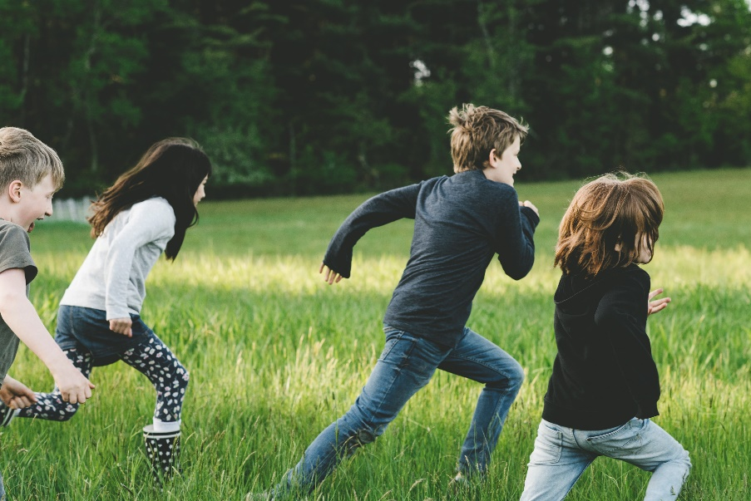
UXO can be found anywhere
Notes:
UXO can be found anywhere:
Bushwalking
Holidaying, camping
Off-road BMX biking trail riding
Farming, horse riding
At the beach
Underwater
Let’s always keep our eyes open, and stay away from unusual objects.

Slide 12
HOW TO AVOID DANGER

Slide 13
What is being done about UXO now?
The Department of Defence is:
Making UXO safe when they are found
Providing information to help people like us!
Limiting access to potentially contaminated Defence land
Keeping records of land affected by UXO
Providing input to development and zoning proposals
Notes:
The Department of Defence is helping to inform and educate people about the risks associated with UXO, so that we don’t hurt ourselves or our loved ones.
Defence’s responsibility in relation to UXO is determined by the Federal Government.
Specifically, the Department of Defence is required to:
make UXO safe when it is found. Defence has especially trained, professional bomb disposal experts.
controlling public access to Defence land that may be contaminated by UXO.
providing information to people like all of us!
keeping records of land affected by UXO.
Providing input to development and zoning proposals regarding possible UXO on the affected areas.
More information can be found at www.defence.gov.au/uxo

Slide 14
What should we do if we see something?
Don’t touch
Don’t touch it!
Mark
Mark the location
Report
Report it to the police by calling 000.
Notes:
If you do discover an item and suspect it could be UXO, the safe thing to do is – Don’t Touch It, Mark the Location and Report It to the police.
Don’t touch the object at all, or poke at it with anything. People can die if they disturb UXO.
The only reports of injury or death from UXO have been associated with someone touching or moving it. If it is left alone, it is not harmful, but authorities must be told where it is, so it can be safely removed or destroyed.
If you see something suspicious, be safe, stop, step back and mark the location by leaning three sticks together, at least 2-3 metres from the object. This will keep others safe by preventing them accidentally stepping near or on the UXO.
You can also record the location, by dropping a GPS pin in maps on your mobile phone.
Report it to police immediately, by calling 000.
Remember, danger can easily be avoided as long as the UXO is not touched, disturbed or moved in any way.
Police will secure the area and determine if a suspected item is UXO. If so, Defence experts will be notified, and specially trained bomb disposal professionals will work to make the item and area safe again.

Slide 15
Unexploded Ordnance Video
Notes:
UXO are extremely dangerous and sadly, can be found anywhere.
Over the years, military training has taken place in many locations, not just in places where we currently have Defence bases or training areas.
Outside of current Defence Training Areas, UXO may be found on land that was previously used for military training purposes.
UXO can be found in most States and Territories and the Department of Defence has undertaken research to identify and define these locations.

Slide 16
For more information visit www.defence.gov.au/uxo
Notes:
Thank you everyone for paying attention here today, I know we have all learned some really important information that we can now use to help keep each other safe.
In summary, you now know:
What UXO is and how to identify it
The history of UXO
What we can do to avoid danger
If anyone would like to read more about UXO, or share this information with other friends or family, visit www.defence.gov.au/uxo

